Slide 1

LE palais du bonbon
DATA PROject / BI
Anthony LUQUE, Anaïs BANOS, Dylan CATTELAN, Cédric MONTES
CESI EXIA A3
06/07/2018

Slide 2
summary
Situation
Database
Generator
Reporting
Indicators / Dashboard
Axes for improvement
Optimization
Manufacturing and Conditioning Services
Picking Service
Shipping Service
Notes:
I’ve divided my presentation into 5 parts/sections, They are….

Slide 3
Context
Servers unavailable
Data loss
Optimize machine productivity
Optimize the packaging / shipping services
Context
Database
Optimization
Generator
Reporting
Situation
Notes:
antho

Slide 4





situation
Le Palais du Bonbon
Database
Python GENERATOR
Manufacturing
Conditioning
ETL
HMI BI
Picking
Shipping
Database
Context
Database
Optimization
Generator
Reporting
Situation
Notes:
2 PARTS :
CONDITIONNING PART / ADMINISTRATION PART
Extract, Transform and Load

Slide 5
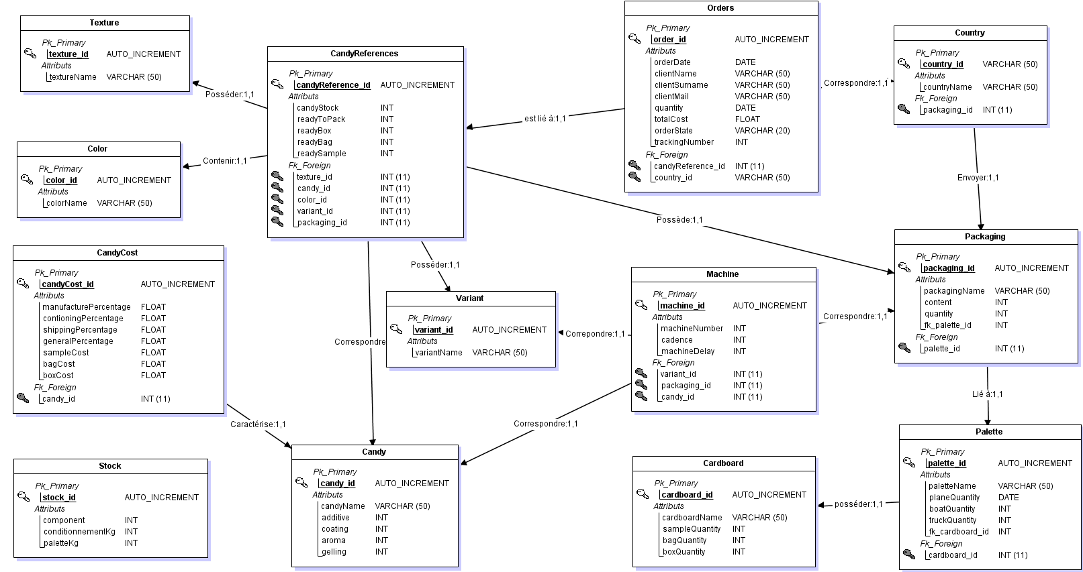
Database – MLD
- Scalability
- Optimization
- Accessibility
Context
Database
Optimization
Generator
Reporting
Situation
Notes:
Scalability
Optimization
Accessibility
is a method of analysis, design and management of IT project.

Slide 6
generator
Generator grabs data from ORACLE DB
Python GENERATOR
Generates random Orders
Check if references exists
Deals with Component stocks
Calculates Packaging/ Shipping fees
ORACLE Database
INSERT INTO Orders, CandyReferences
UPDATE Stocks
Context
Database
Optimization
Generator
Reporting
Situation
Notes:
dylan

Slide 7
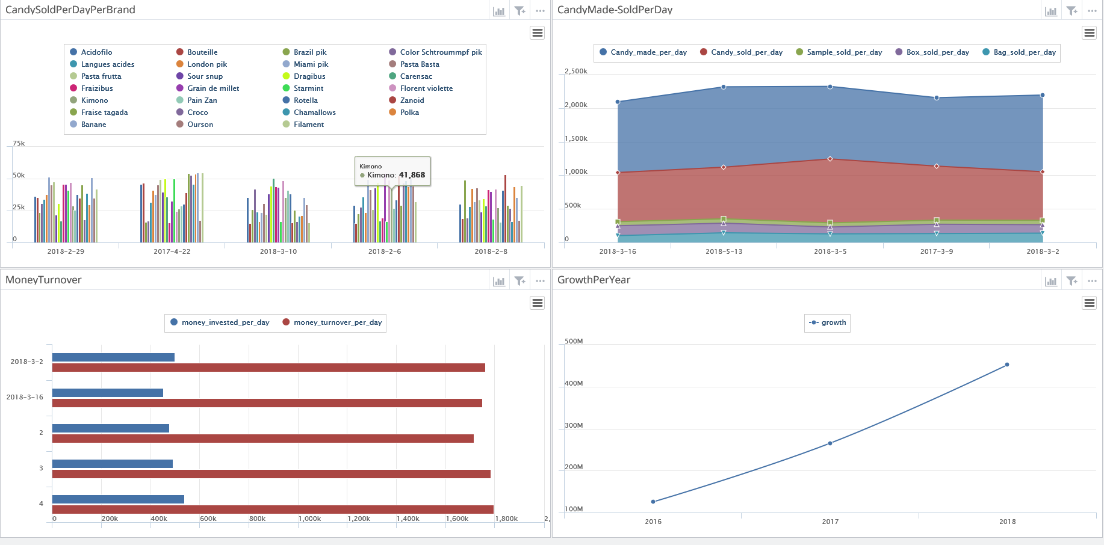
Reporting Indicators / Dashboards
Candy sold per day per brand
Candy made / sold per day
Money turnover
Growth per year
Context
Database
Optimization
Generator
Reporting
Situation
Notes:
cedric

Slide 8
Optimizations
Improve Production
Improve the Picking organization
Improve Shipping
Operationnal Research
Graph theory
- 45% shipping time
100% maximized production
Context
Database
Optimization
Generator
Reporting
Situation
Notes:
Concerning the calculus we decided to we capped the production time

Slide 9
Manufacturing / Conditioning Services
4 machines
1 per variant (sugar, jelly, acid)
1 bivalent (sugar or jelly)
Each machine has
Characteristics
Cadency
Delay
6 machines
3 for Bags
2 for Boxes
1 for Samples
Maximised production
Minimised functionning time
Context
Database
Optimization
Generator
Reporting
Situation
Notes:
Bivalent : it can do either sugar or jelly candy
Their own delay which applies whenever they change candy
we decided to optimize their function time thanks to … we can maximise
Every single calculus is in the final repport we can follow up with anthony

Slide 10
Picking / Shipping Services
Optimize picking zone
2 loops
20 bays of 100 picking zone
3888 unique references
27 types of candy
144 zones / candy
97% used
112 free spots
Optimize Shipping
Trucks delivery service
Graph
Peaks : countries
Ridges : distance (km)
Dijkstra algortithm
Context
Database
Optimization
Generator
Reporting
Situation
Notes:
Peaks
reages

Slide 11
Any questions?

